Slide 1
Mobile Breaking News Focus Group Findings
March 2017
Prepared by Katie Elfering
Notes:
The UI Model for the Bing Knowledge platform. The UI Platform for the data platform.

Slide 2
Methodology

Slide 3
Research Methodology
Participants were recruited from the Bing Insiders group. Participants were Bing Insiders who use a mobile device to consume news on a regular basis.
Two focus group session were conducted, each lasting 45-minutes.
Sixteen total participants shared their feedback in these sessions, which included behavioral questions about mobile breaking news as well as a design walkthrough of the various experiences and features.

Slide 4
Key Findings
In general, participants liked the overall idea of the mobile breaking news experience from Bing, although they had mixed feelings on some of the feature execution.
Participants preferred options that let them get to the content as quickly as possible, whether that was an aggregated vertical page or answer, or to an article they wanted to read. Minimizing taps and getting right to the information were the most desired outcomes.
Participants appreciated the aggregation that Bing provided, especially the Rundown.
Participants also preferred experiences that provided a variety of content types (articles, videos, etc.) that let them choose the best way to get information given their current context.

Slide 5
Mobile News Behaviors
All of our participants use their mobile device to consume news content.
The majority consume mobile news on a smartphone; only a few use a tablet for mobile news consumption.
Many participants use Bing on their mobile device to follow news already, which is expected as they are Bing Insiders. Other key apps/sources for mobile news include: Facebook, CNN, Buzzfeed, Flipboard, Google app, Yahoo, Washington Post app, and email.
Participants split their mobile news consumption time between apps and mobile browser.
Most participants already receive mobile breaking news notifications, most often from the apps mentioned above.
Those that don’t currently receive mobile breaking news notifications choose said they were receiving too many notifications and that the notifications were not all “breaking news.” They expressed a desire to be able to customize the topics for which they would get these alerts.
Some participants also mentioned using home screen controls as opposed to notifications as a means of getting breaking news alerts.
After receiving a mobile breaking news notification, most participants indicated that they read the notification to determine if it was worth engaging. If it met their interests or was contextually relevant, they might tap on it; if not, they wouldn’t. Their behavior was heavily based on context, location, and interest in the topic.

Slide 6
Vertical Click-Through

Slide 7
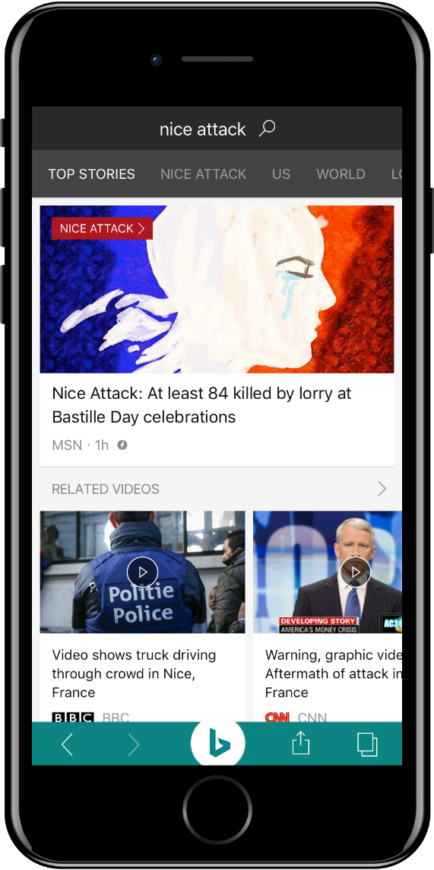
Is it clear that this is a breaking news story?
Participants were asked if it was clear that the Nice Attack story was breaking news.
It was not clear to the majority of participants that this was breaking news. Most assumed it was just another news story.
Participants asked for a header or label that indicated “breaking news” to show the timeliness of the story.
Most participants didn’t notice the “Nice Attack” header next to “Top Stories,” and instead indicated that they would click on the image or article title to get more information about this event.

Slide 8


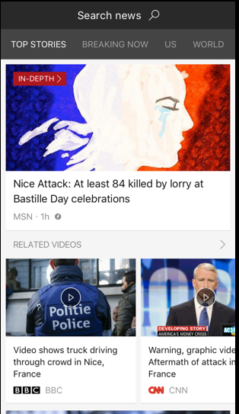
Preferred Header in Vertical: Breaking Now
Per the previous question, it wasn’t surprising that all participants preferred the “Breaking Now” header over the “Nice Attack” option.
The “Breaking Now” header made it clear that the content was timely, breaking news, and that they could see all breaking news in that vertical.
Participants called the “Breaking News” header consistent, clear, obvious, and habitual. They mentioned that having a story topic as a header was confusing.
Some participants did mention that the term “Breaking Now” (and even “breaking news”) could be to generic, as too many things are classified as “breaking” lately and the term is watered down.
It was not clear to participants that the “Nice Attack” header would be dynamic based on breaking news events.

Slide 9
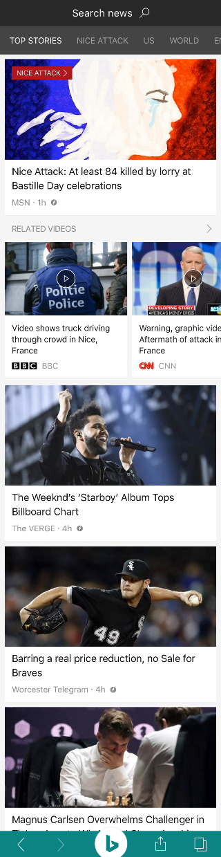
Related Videos
Most participants understood that the “Related Videos” were connected to the breaking news event.
However, many participants mentioned that if they had not been directed to look at the videos, they would not have noticed them. Participants suggested a bolder title for that section or some sort of design element to help them stand out from the rest of the news and show their relation to the breaking news
Participants expressed mixed opinions about the inclusion of videos in general. Some participants mentioned that videos are often too long, take too much data, and don’t give them the information they need, indicating a preference for text that is easier to skim. Participants preferred an option for breaking news that gave them the choice between text and video.
The horizontal scroll navigation was not clear to many participants without explanation, despite many indicating familiarity with this type of navigation in other apps. Participants suggested a bigger arrow to help indicate the navigation.

Slide 10
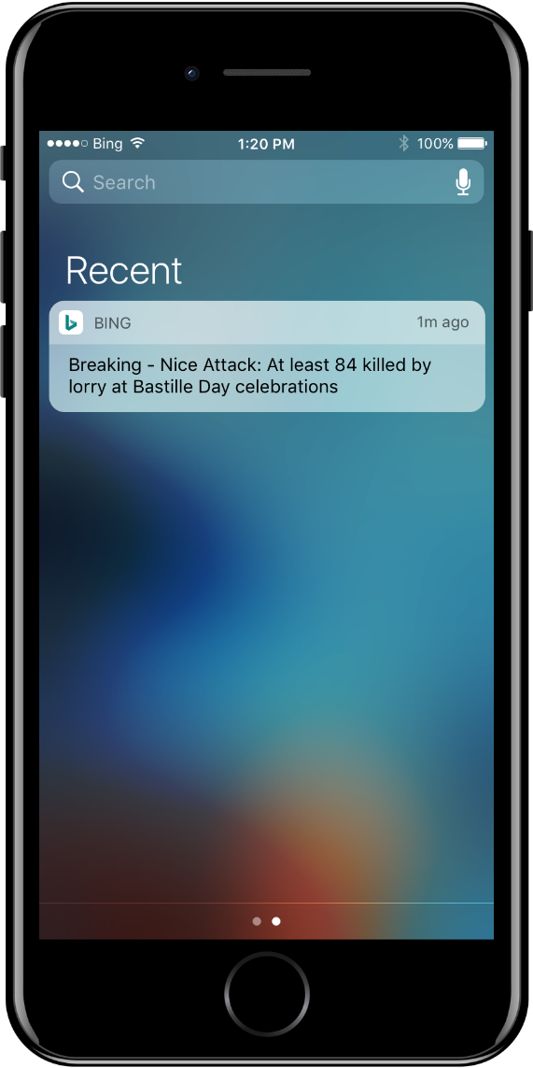
Notification from Bing
Participants liked the concept of notifications from Bing, but per their earlier responses, indicated that their interaction with the notification would be driven by interest and context.
While participants did not expect Bing to send breaking news notifications on mobile, many felt it would be a pleasant surprise, especially given Bing’s ability to aggregate news from multiple sources.
“I really like this idea!”
“This would be very useful.”
“I would like a notification from Bing because then I can see the news from lots of sources.”
Participants indicated a desire to customize the categories and topics about which they would receive Bing mobile breaking news notifications. Customizing the frequency was also a big ask.

Slide 11
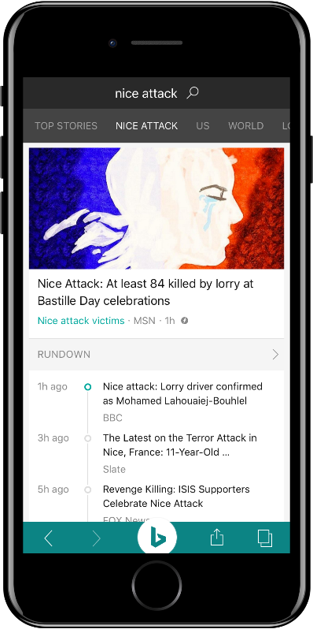
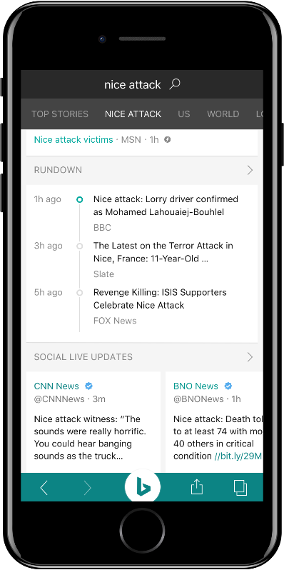
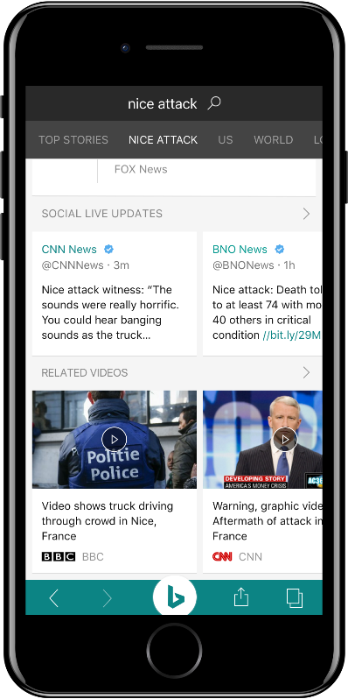
Vertical Experience Overall
In general, participants liked the overall Vertical Click-Through Experience. Specifically, they liked the aggregation and summarization of information, which they expect from Bing News.
“I like that the ‘whole story’ is on one page and I can choose what information I want to read about it and how I want to engage with it.”
Participants liked that the notification took them directly to the Breaking News vertical (as opposed to the general “Top Stories” page), saving time and taps. Many indicated that it would be “annoying” to tap a notification and not go directly to the story.
Participants gravitated to the Rundown feature and liked this element on the page…but did not like the name. (This was especially true given that this story involved people being rundown by a car.)
Participants suggested rearranging the layout to put social updates lower (as it was less of a priority) and articles/videos higher (as this news was more important to them).
Participants asked for additional features to be included, like a Map, additional news articles, and a wiki/reference section. Some participants asked that a map be included under the Rundown.

Slide 12
Vertical Experience Key Features
RUNDOWN
Participants really liked the concept and execution of this feature, especially its placement at the top of the scroll under the first article.
However, participants did NOT like the name and didn’t feel like it was appropriate for the feature. Timeline or Timeline of Events was a much preferred title for this feature.
Participants also mentioned that having the sources under each entry was valuable, especially if they were clickable links to article and videos. This was seen as building credibility and utility.
SOCIAL LIVE UPDATES
This feature was less liked by participants, who felt it was less useful and somewhat redundant (given results from the same media outlets in other parts of the experience).
Participants felt that only having Tweets included made this feature less useful and asked to have other social included (as the title suggests).
Most participants felt this feature could be lower in the scroll or be an expandable feature up to the users’ discretion.
RELATED VIDEOS
Most participants said they wanted text-based articles before videos in the scroll, as text is faster/easier to skim on mobile than video. This was especially true for videos with no clear timestamps.
That said, participants like the option to watch videos and appreciated their inclusion in the vertical scroll.

Slide 13
Answer Click-Through

Slide 14
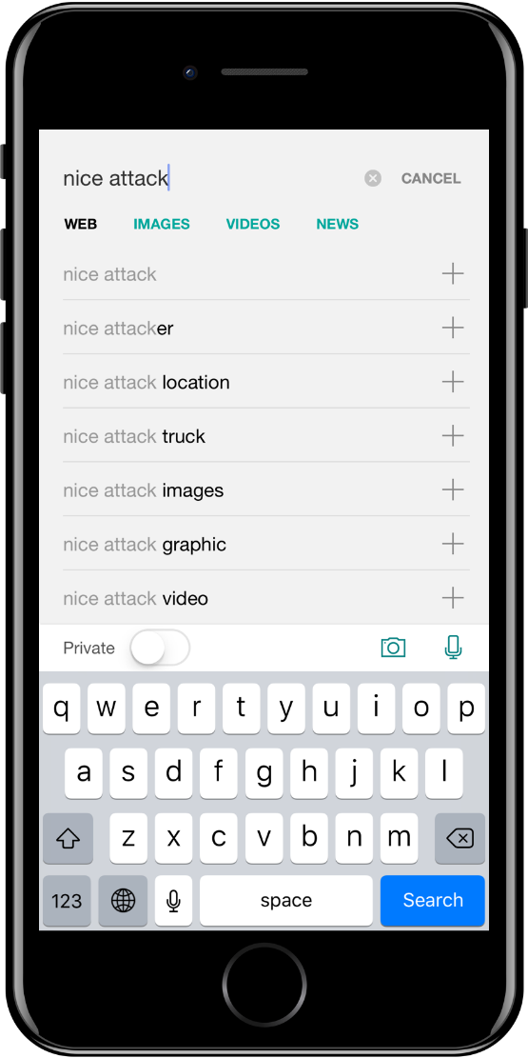
Do you search for news on mobile?
Participants were asked if they use their mobile device to search for breaking news that they have heard about though another form of media.
Most participants said they do this, at least sometimes.
If they don’t, it’s because they get alerts that take them directly to topic/story/breaking news, eliminating the need to search.
Unprompted, many participants mentioned that they would like to use voice-based search to search for news.

Slide 15
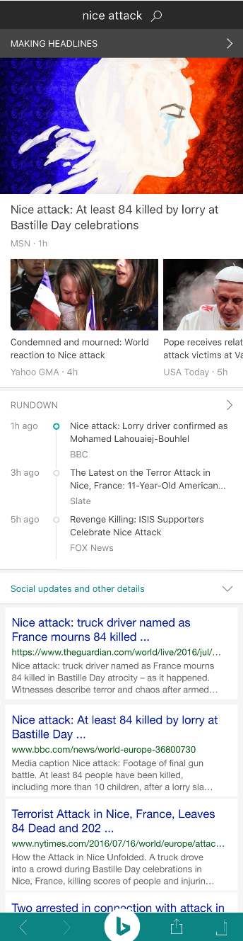
Answer Click-Through Overall
In general, participants liked the overall look and feel of the breaking news answer, with a few caveats.
As this is a news story, participants asked about easy navigation to get to the main news vertical, which was not clear in this design.
While participants liked the quantity and quality of news around this topic in this answer, they also indicated a desire to have a clearer indicator that it is “Breaking News.”
Participants did not like the header of “Making Headlines.” They were not clear on its meaning, felt it “sounds too much like celebrity gossip,” and doesn’t convey the timeliness of a breaking news event.
Most participants would click on the top article if they wanted more info on this topic/story; they didn’t really notice other navigation arrows in the answer.
In fact, most participants were unsure or unclear what the arrows next to “Rundown” and “Social updates and other details” would do, or they didn’t notice them at all.

Slide 16
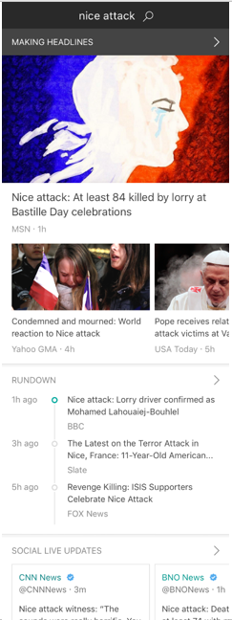
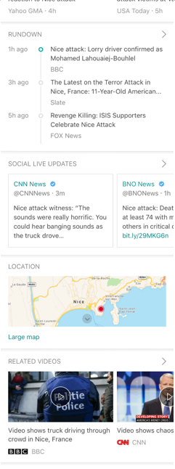
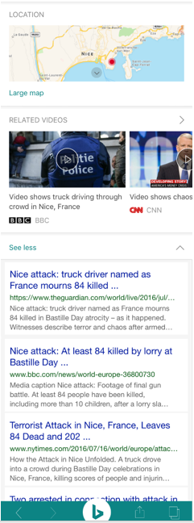
Answer Click-Through Navigation
Despite not noticing or understanding the arrows by Rundown/Social, participants liked the expanded answer. It was not what most were expecting when clicking on those arrows, but many were pleasantly surprised by the results.
Participants expected to see more articles/search results when clicking on those arrows.
Navigation through the answer was a challenge for many participants, who felt that arrows were not clear or noticeable, and that expectations for what they’d get were not clear.
In fact, many participants indicated that they would prefer the expanded answer as their initial search result, instead of having to navigate through it to expand features.

Slide 17
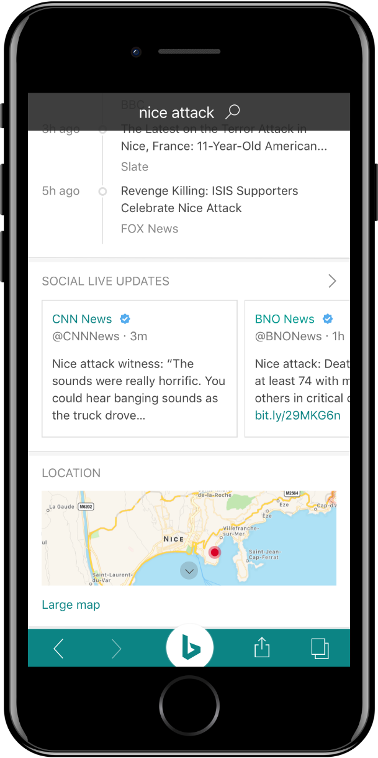
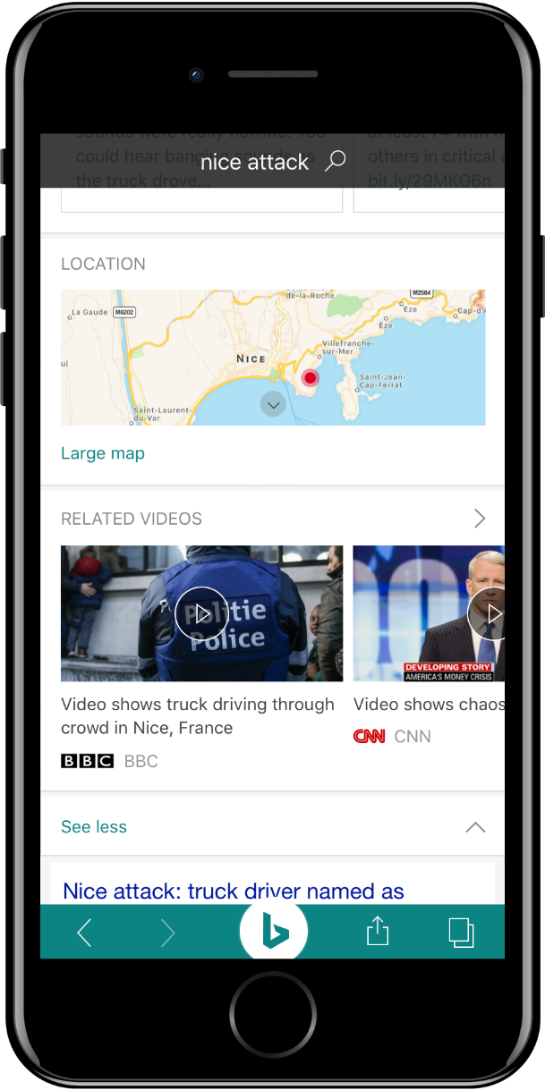
Answer Click-Through Specific Features
Participants generally liked the map feature, although about half expressed concern about the size of the feature on a small screen (i.e. taking up too much real estate, hard to read/engage on a small screen, etc.).
Only a few participants did not find the map valuable.
Participants felt that the placement of the map was fine, although some felt it should be in the Rundown and others felt it could be lower in the scroll.

Slide 18
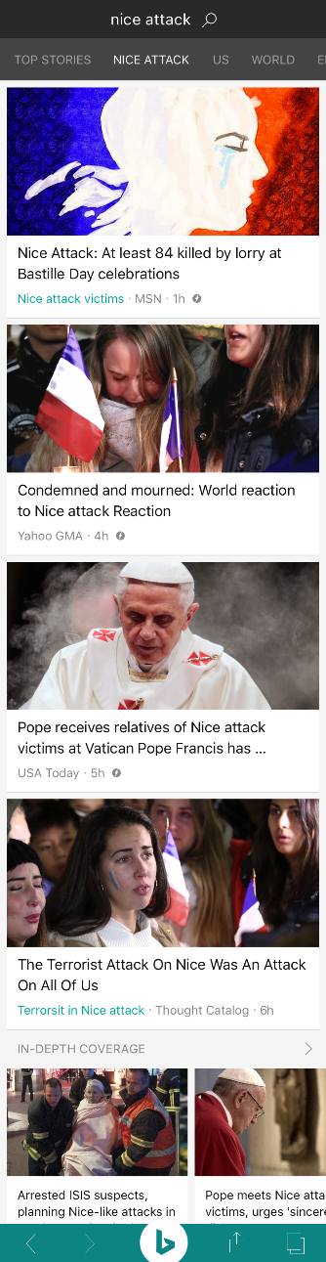
Answer Click-Through Article Expectations
Participants overwhelmingly expected that clicking on the top article would open the article, and expressed great frustration that it would instead take them to the News Vertical.
In fact, this was the most frustrating/annoying feature of the entire focus group for most participants, who indicated that this would most likely cause them to end their mobile session.

Slide 19
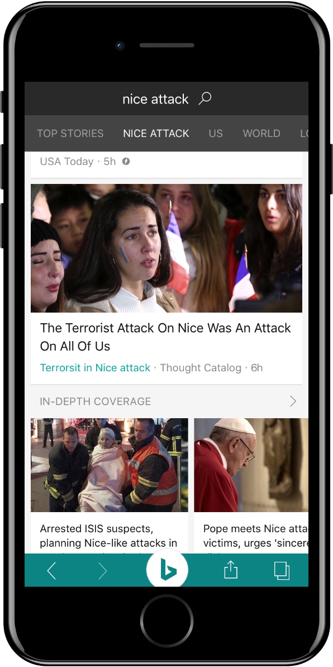
Answer Click-Through Overall
Participants were confused by the “In-Depth Coverage” section, as they assumed all content would be “in-depth” and didn’t understand how this was different. It felt redundant.
Some participants felt that this feature would make more sense under the Rundown (instead of in the news vertical), as it would expand on the short summary points in that timeline.

Slide 20
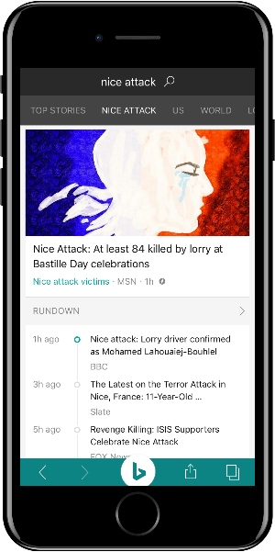
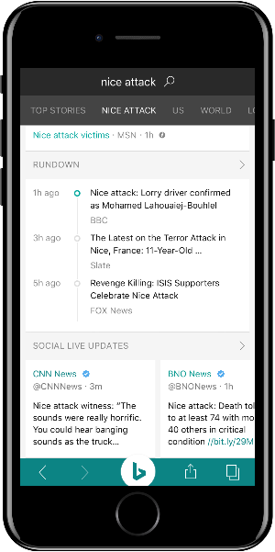
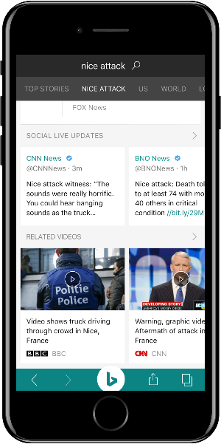
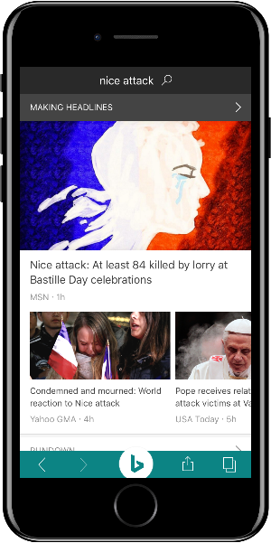
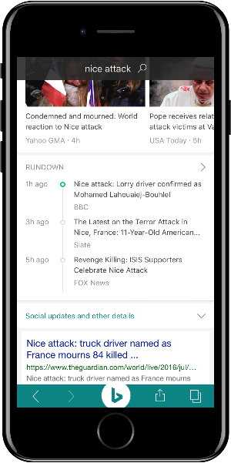
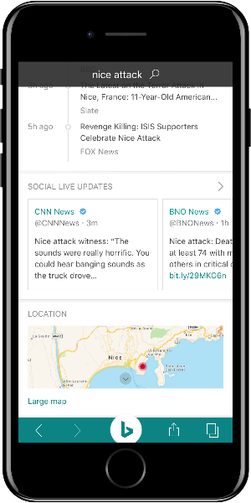
Vertical Click-Through
Answer Click-Through
Participants were almost evenly split on their preference for the Vertical or the Answer click-through. The Vertical option was slightly preferred, but most participants cited specific elements of each option that they liked instead of one or the other.
In the Vertical Click-Through, participants liked the notifications going directly to the news/event vertical and the ability to tap into other news topics. They also liked the Rundown feature and the overall simplicity of the design.
However, if they were searching for breaking news, the Answer Click-Through was preferred, with minor tweaks to layout/organization and easier access to both related articles and the news vertical to see other news

Slide 21
Additional Features

Slide 22
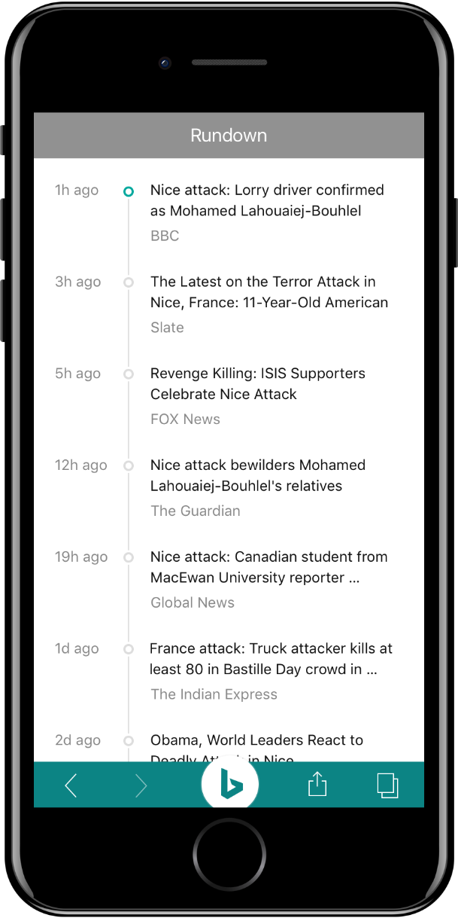
Rundown
Participants were unanimous: the rundown has to be scrollable and clickable.
The more dynamic, the better– but participants were clear that it wouldn’t make sense to include as a feature if it wasn’t dynamic. Scrolling, real-time updates, clickable links– the more they could engage with it, the more they liked it.
That said, they still didn’t like the name and would like to see that changed to Timeline or Timeline of Events.

Slide 23
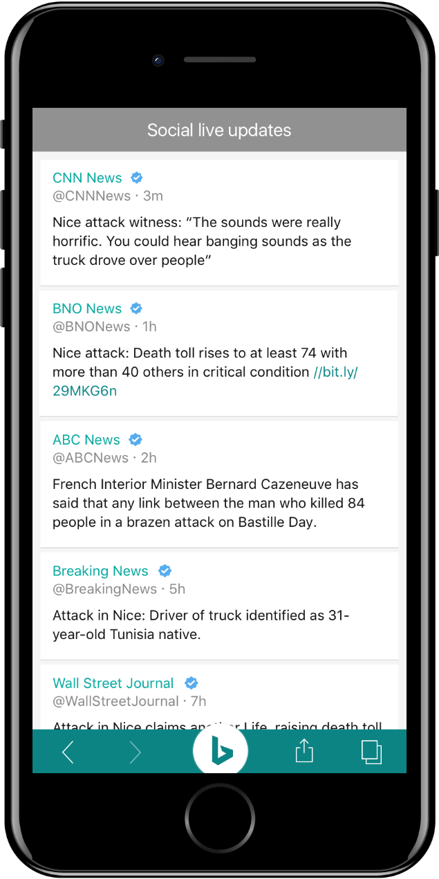
Social Live Updates
Participants were less enthusiastic about this feature, compared to the Rundown.
Specifically, participants felt that the title “Social Live Updates” didn’t work; it felt redundant to some and, if it wasn’t updated in real-time, misleading.
Participants were also confused about why it was called “social” when only Twitter was included.
Beyond the title, participants felt that the content was likely redundant with the other features/search results, as many were sources they found in other aspects of the Bing Breaking News experience.
A few participants who were Twitter users mentioned that they’d likely just go to Twitter for this content, where they have more customized feeds already.

Slide 24
Additional Feedback

Slide 25
Additional Feedback
Participants were asked to share any additional feedback about the overall mobile breaking news experience on the Bing app. Their ideas include:
More global/language options in the results
More results with links as opposed to just text
Hashtags/trending topics within the social updates to show users what is getting the most likes/shares as events unfold
Cortana integration
Cross-device integration– ability hop from mobile to PC
Keeping the screen size (small) in mind and not cramming too much on there; minimizing the scrolling
Incorporate “Read Later” or “Save for Later” icons for things people want to come back to

